Slide 1
Run interactive queries with Azure Synapse Serverless SQL pools

Slide 2
Agenda
Describe Azure Synapse serverless SQL pools
Querying a data lake store using serverless SQL pools in Azure Synapse Analytics
Securing access to data through using serverless SQL pools in Azure Synapse Analytics
Notes:
TALKING POINTS
Let’s set an agenda for today’s presentation in which we are going to discuss the following:
Describe Azure Synapse serverless SQL pools
Querying a data lake store using serverless SQL pools in Azure Synapse Analytics
Securing access to data through using serverless SQL pools in Azure Synapse Analytics
PRESENTER NOTES AND GUIDANCE
Don’t take too much time in order to present the agenda. Make the points in the topics.

Slide 3
Describe Azure Synapse serverless SQL pools
1
Notes:
TALKING POINTS
Let’s go over what Azure Synapse serverless SQL pools is. How many of you have the need to explore data, or perform ad hoc transformation?
PRESENTER NOTES AND GUIDANCE
Poll your audience.

Slide 4
Synapse serverless SQL pools
Logical data warehouse
Create objects (such as VIEWs and External Tables) that provide you with a SQL metadata layer over the data in the lake to create a logical data warehouse. Once these objects are created, any tool that can connect to serverless SQL pool will see these objects as regular SQL Server objects
Every Azure Synapse Analytics workspace comes with serverless SQL pool endpoints so you can start querying data in seconds to minutes in a data lake as soon as the workspace is created. There's no infrastructure to setup or clusters to maintain.
Data Exploration
Data transformation
Browse the data lake and get initial insights about the data. Using Azure Synapse Studio, you can explore the data both graphically and programmatically.
Serverless SQL pool enables you to execute transformation statements over the data in the lake and store the results back to the data lake in a specified file format.
Notes:
Every Azure Synapse Analytics workspace comes with a built in serverless SQL pool endpoint that you can be used to query files in a data lake.
Serverless SQL pool is serverless, hence there's no infrastructure to setup or clusters to maintain. A default endpoint for this service is provided within every Azure Synapse workspace, so you can start querying data as soon as the workspace is created. There is no charge for resources reserved, you are only being charged for the data processed by queries you run; so this model is a true pay-per-use model.
If you use Apache Spark for Azure Synapse in your data pipeline, for data preparation, cleansing or enrichment, you can query external Spark tables you've created in the process, directly from serverless SQL pool. Use Private Link to bring your serverless SQL pool endpoint into your managed workspace VNet.

Slide 5
Azure Synapse Serverless SQL Pools
Every Azure Synapse Analytics workspace comes with serverless SQL pool endpoints so you can start querying data in seconds to minutes in a data lake as soon as the workspace is created. There's no infrastructure to setup or clusters to maintain.
Notes:
TALKING POINTS
Every Azure Synapse Analytics workspace comes with serverless SQL pool endpoints that you can use to query data in the lake.
Serverless SQL pool is a query service over the data in your data lake. It enables you to access your data through the following functionalities:
A familiar T-SQL syntax to query data in place without the need to copy or load data into a specialized store.
Integrated connectivity via the T-SQL interface that offers a wide range of business intelligence and ad-hoc querying tools, including the most popular drivers.
Serverless SQL pool is a distributed data processing system, built for large-scale data and computational functions. Serverless SQL pool enables you to analyze your Big Data in seconds to minutes, depending on the workload. Thanks to built-in query execution fault-tolerance, the system provides high reliability and success rates even for long-running queries involving large data sets.
Serverless SQL pool is serverless, hence there's no infrastructure to setup or clusters to maintain. A default endpoint for this service is provided within every Azure Synapse workspace, so you can start querying data as soon as the workspace is created.
There is no charge for resources reserved, you are only being charged for the data processed by queries you run, hence this model is a true pay-per-use model.
If you use Apache Spark for Azure Synapse in your data pipeline, for data preparation, cleansing or enrichment, you can query external Spark tables you've created in the process, directly from serverless SQL pool. Use Private Link to bring your serverless SQL pool endpoint into your managed workspace VNet.
PRESENTER NOTES AND GUIDANCE
Review the following page for introductory information:
Serverless SQL pool - Azure Synapse Analytics | Microsoft Docs

Slide 6
Comparing dedicated SQL Pools with serverless SQL pools in Azure Synapse Analytics
Dedicated SQL Pool
Serverless SQL Pool
Used for Data Warehouse operations
Provides predictable performance and costs
Reserves processing power for data stored in SQL tables
Used for data preparation or ad-hoc queries against unstructured data.
Provides an always available SQL endpoint for unplanned workloads
Enables interactive querying
Notes:
TALKING POINTS
Synapse SQL offers both serverless and dedicated resource models, offering consumption and billing options to fit your needs. For predictable performance and cost, provision pools to reserve processing power for data stored in SQL tables. For unplanned or bursty workloads, use the serverless, always-available SQL endpoint.
PRESENTER NOTES AND GUIDANCE
Review:
What is Azure Synapse Analytics:
https://docs.microsoft.com/en-us/azure/synapse-analytics/overview-what-is

Slide 7
Querying a data lake store using serverless SQL pools in Azure Synapse Analytics
2
Notes:
Talking Points:
Let’s look at how you can query the common files that are stored in an Azure Data Lake

Slide 8
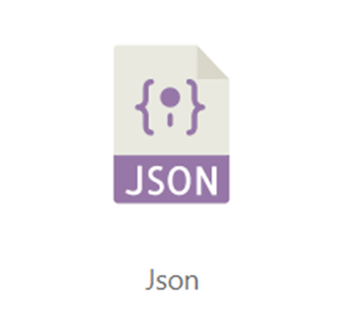
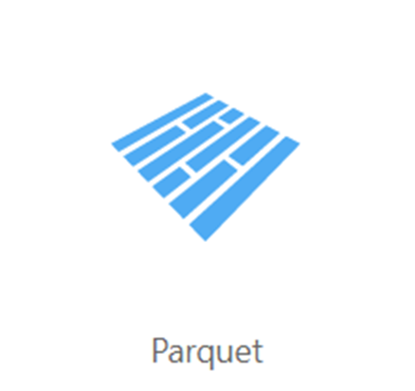
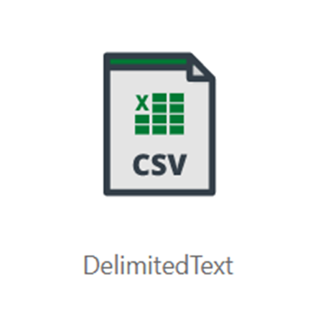
Common files to query
Parquet
JSON
Delimited Text
Notes:
TALKING POINTS
Serverless SQL pool enables you to query data in your data lake. It offers a T-SQL query surface area that accommodates semi-structured and unstructured data queries. For querying, the following T-SQL aspects are supported:
- Full SELECT surface area, including majority of SQL functions and operators.
- CREATE EXTERNAL TABLE AS SELECT (CETAS) creates an external table and then exports, in parallel, the results of a Transact-SQL SELECT statement to Azure Storage.
To support a smooth experience for in place querying of data that's located in Azure Storage files, serverless SQL pool uses the OPENROWSET function with additional capabilities:
- Query multiple files or folders
- PARQUET file format
- Query CSV and delimited text (field terminator, row terminator, escape char)
- Read a chosen subset of columns
- Schema inference
- filename function
- filepath function
- Work with complex types and nested or repeated data structures
Full details can be explored here:
Query data storage with serverless SQL pool (preview) - Azure Synapse Analytics | Microsoft Docs

Slide 9
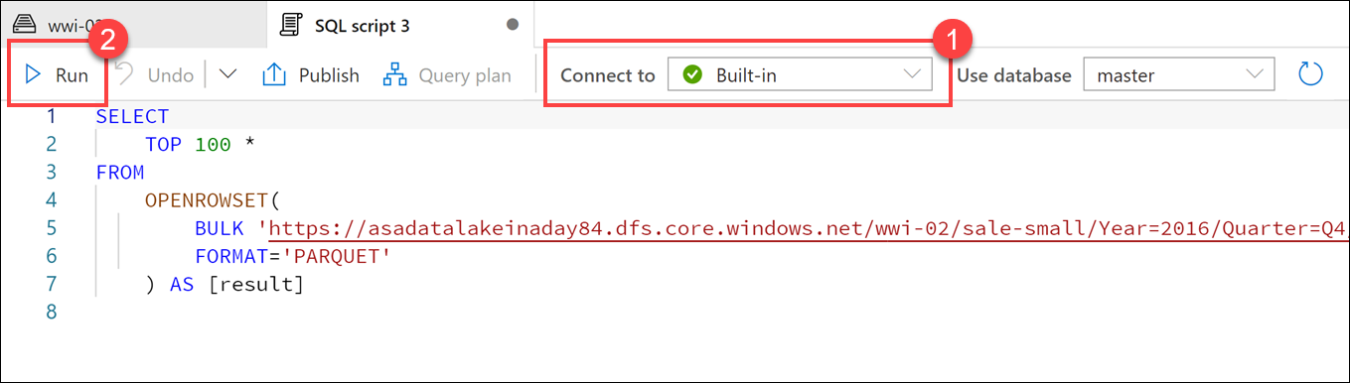
Query data in the lake using Azure Synapse serverless SQL pools
Notes:
Serverless SQL pools enable you to query data in your data lake. They offer a T-SQL query surface area that accommodates semi-structured and unstructured data queries. For querying, the following T-SQL aspects are supported:
- Full SELECT surface area, including a majority of SQL functions and operators.
- CREATE EXTERNAL TABLE AS SELECT (CETAS) creates an external table and then exports, in parallel, the results of a Transact-SQL SELECT statement to Azure Storage.
To support a smooth experience for in-place querying of data that's located in Azure Storage files, serverless SQL pool uses the OPENROWSET function with additional capabilities including:
- Query multiple files or folders
- Query PARQUET file format
- Query CSV and delimited text (field terminator, row terminator, escape char)
- Read a chosen subset of columns
- Use schema inference
- Use the filename function
- Use the filepath function
- Work with complex types and nested or repeated data structures

Slide 10
Querying parquet files in a data lake
Notes:
TALKING POINTS
Understanding data through data exploration is one of the core challenges faced today by data engineers and data scientists as well. Depending on the underlying structure of the data as well as the specific requirements of the exploration process, different data processing engines will offer varying degrees of performance, complexity, and flexibility.
In Azure Synapse Analytics, you can use either SQL, Apache Spark for Synapse, or both. Which service you use mostly depends on your personal preference and expertise. When conducting data engineering tasks, both options can be equally valid in many cases. However, there are certain situations where harnessing the power of Apache Spark can help you overcome problems with the source data. This is because in a Synapse
Notebook, you can import from a large number of free libraries that add functionality to your environment when working with data. There are other situations where it is much more convenient and faster using serverless SQL pool to explore the data, or to expose data in the data lake through a SQL view that can be accessed from external tools, like Power BI.
- In Synapse Studio, navigate to the Data hub.
- Select the Linked tab and expand Azure Data Lake Storage Gen2. Expand the primary ADLS Gen2 account and select the container. Navigate to the folder, and right-click on the parquet file, select New SQL script, then Select TOP 100 rows.
- As per the screenshot in the slide, Ensure Built-in is selected (1) in the Connect to dropdown list above the query window, then run the query (2). Data is loaded by the serverless SQL endpoint and processed as if was coming from any regular relational database.

Slide 11
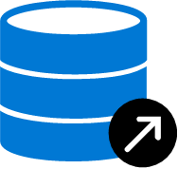



CREATE DATABASE [YourDatabaseName]
Database
Create metadata objects in Azure Synapse serverless SQL pools
CREATE DATABASE SCOPED CREDENTIAL [sqlondemand]
WITH IDENTITY='SHARED ACCESS SIGNATURE',
SECRET = 'sv=2018-03-28&ss=bf&srt=sco&sp=rl&'
Database
scoped credential
CREATE EXTERNAL DATA SOURCE SqlOnDemandDemo WITH (
LOCATION = 'https://sqlondemandstorage.blob.core.windows.net',
CREDENTIAL = sqlondemand );
External data source
CREATE EXTERNAL FILE FORMAT QuotedCsvWithHeaderFormat
WITH
( FORMAT_TYPE = DELIMITEDTEXT,
FORMAT_OPTIONS ( FIELD_TERMINATOR = ',', STRING_DELIMITER = '"', FIRST_ROW = 2 ) );
External file format
CREATE EXTERNAL TABLE populationExternalTable
( [country_name] VARCHAR (100) COLLATE Latin1_General_BIN2,
[year] smallint, [population] bigint )
WITH
( LOCATION = 'csv/population/population.csv’,
DATA_SOURCE = sqlondemanddemo,
FILE_FORMAT = QuotedCSVWithHeaderFormat );
External Table
Notes:
Metadata objects help you query data or optimize your existing data transformation pipeline through Azure Synapse serverless SQL pools. It also enables clients connecting to the serverless SQL pool to discover the objects to query the data in the lake. This essentially creates a semantic layer over which tools like Power BI can use to easily consume the data.
(Click) You should start of by creating a database, and then you can create the following objects to organise the data so that it can be accessed securely:
(Click) Database scoped credential
(Click) External data source
(Click) External file formats
(Click) External tables
(Click) Views
Metadata objects can help you simplify understanding the data that is held in the files of a data lake by enabling you to define a semantic layer on top of the files. This initial step can also simplify the transformation that you may use against the data as it can be presented as tables in the serverless SQL pool.
The ability to create metadata objects within a serverless SQL pools in Azure Synapse Analytics provides some opportunities for customers to use it as a proof-of-concept layer for any potential enterprise data warehouses that they may consider creating. It is important to note; however, that it is better to transition the proof of concept to a dedicated SQL pools where the data and resources are persisted should the proof-of-concept be a success, and the decision is made to make the enterprise data warehouse more permanent.

Slide 12
Securing access to data through using SQL serverless in Azure Synapse Analytics
3
Notes:
Talking Points:
Lets look at the security considerations

Slide 13

Securing access to data in a data lake when using Azure Synapse Analytics
Authentication
Authorization
Encryption
Notes:
Talking Points:
There are 3 areas of security to be aware of with Azure Synapse SQL pools
Authentication is the process of proving the user is who they claim to be. A user connects to a database using a user account. When a user attempts to connect to a database, they provide a user account and authentication information. The user is authenticated using one of the following two authentication methods:
SQL authentication.
With this authentication method, the user submits a user account name and associated password to establish a connection. This password is stored in the master database for user accounts linked to a login or stored in the database containing the user accounts not linked to a login.
Azure Active Directory Authentication
With this authentication method, the user submits a user account name and requests that the service use the credential information stored in Azure Active Directory (Azure AD).
Logins and users: A user account in a database can be associated with a login that is stored in the master database or can be a user name that is stored in an individual database.
A login is an individual account in the master database, to which a user account in one or more databases can be linked. With a login, the credential information for the user account is stored with the login.
A user account is an individual account in any database that may be, but does not have to be, linked to a login. With a user account that is not linked to a login, the credential information is stored with the user account.
Authorization to access data and perform various actions are managed using database roles and explicit permissions. Authorization refers to the permissions assigned to a user, and determines what that user is allowed to do. Authorization is controlled by your user account's database role memberships and object-level permissions. As a best practice, you should grant users the least privileges necessary.
Transparent data encryption (TDE) helps protect Azure Synapse Analytics against the threat of malicious offline activity by encrypting data at rest. TDE must be manually enabled for Azure Synapse Analytics. TDE performs real-time I/O encryption and decryption of the data at the page level. Each page is decrypted when it's read into memory and then encrypted before being written to disk. TDE encrypts the storage of an entire database by using a symmetric key called the Database Encryption Key (DEK). On database startup, the encrypted DEK is decrypted and then used for decryption and re-encryption of the database files in the SQL Server database engine process. DEK is protected by the TDE protector. TDE protector is either a service-managed certificate (service-managed transparent data encryption) or an asymmetric key stored in Azure Key Vault (customer-managed transparent data encryption).

Slide 14
LAB 2 (Env 2): Run interactive queries with Azure Synapse Serverless SQL pools
60 minutes
Notes:
TALKING POINTS​
​
Let’s put this into reality and show you how it works.​
​
All instructions and context are found in this repository​

